Slide 1
CSA - GESAC GNURadio deep dive
Vlad Popovici (CSA)
William Dion (Sherbrooke University)
APRIL 2, 2022
Ground Station Working Group

Slide 2
What we’ll see
Review installation process of the tools
Basic signal through GNURadio and USRP
Signal filtering with flowgraphs
Signal demodulation with gr-satellite (data)
Example of doppler-shift correction
Uplink example

Slide 3
Note
Software engineering POV
All the code and flowgraphs are accessible inside a .zip given at the end of the presentation
You don’t need a USRP or LimeSDR to code the software of the ground station
With .wav recordings the pipeline can be tested
The structure of the handling of the data can be done with those recordings
You can interrupt and ask questions ☺

Slide 4
Software installation guide
Use Linux (Ubuntu is good, arch is better)
Install GNURadio
https://wiki.gnuradio.org/index.php/InstallingGR
Install USRP Toolchain (build from source):
https://kb.ettus.com/Building_and_Installing_the_USRP_Open-Source_Toolchain_(UHD_and_GNU_Radio)_on_Linux
Install gr-satellites (build from source)
https://gr-satellites.readthedocs.io/en/latest/installation.html

Slide 5
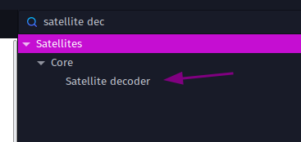
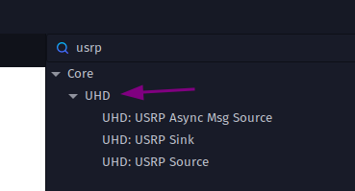
Software installation guide
Don’t worry!
Steps for building from sources are well written
Use google to find out if there is some errors during installation
Validate with CTRL+F in GNURadio:

Slide 6
GNURadio 101
The flowgraphs generate Python code
This Python code can be used by other applications and are not bound to GNURadio
We will use this to our advantage!
GNURadio is just a quick way to create signal filtering with Python libraries

Slide 7
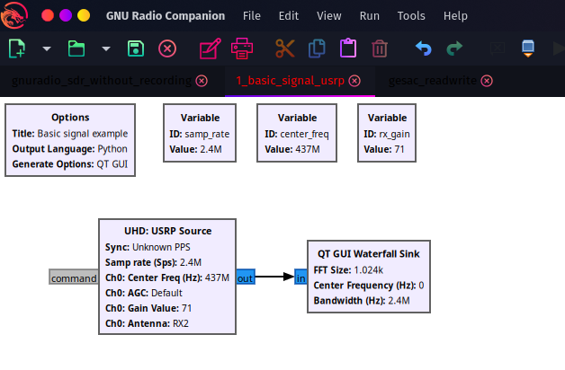
Basic signal through GNURadio
Make use of our USRP (or other) inside a GNURadio flowgraph with sinks
Blue = complex signal
* 437 MHz @ 2.4Mhz = 435.8 to 438.2 MHz

Slide 8
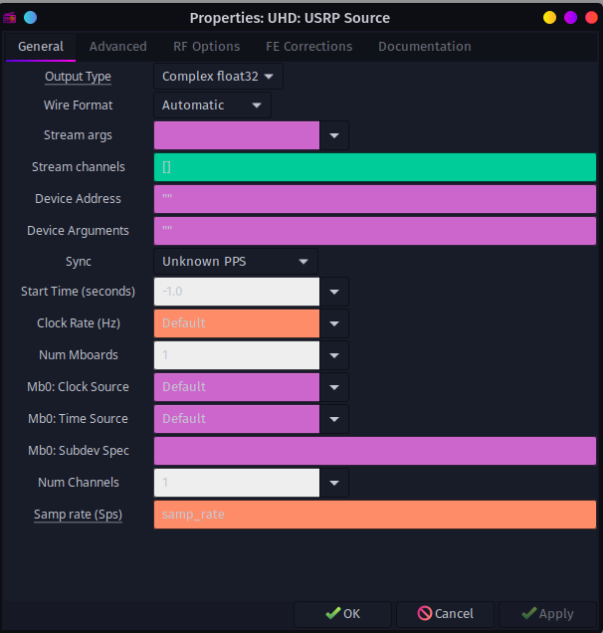
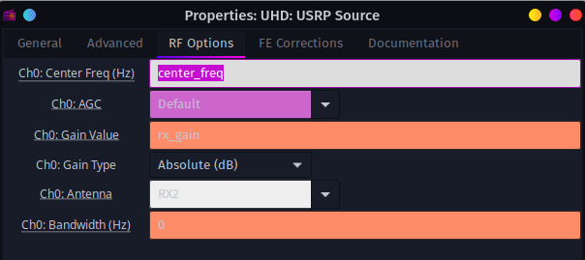
Basic signal through GNURadio
USRP Configuration

Slide 9
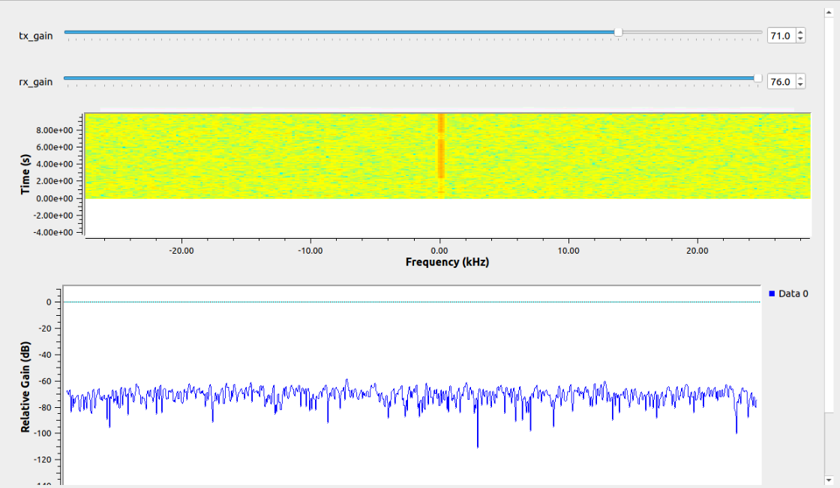
Basic signal through GNURadio
We have something on the flowgraph, now what?
Watch out for the USRP noise centered at 0
We need to find a way to offset our signals from that huge noise line

Slide 10
Filtering signals
Use a Xlating FIR filter to isolate a distant part of the waterfall graph and re-center it to 0 (see 15kHz on the graph)
This lowers the sample rate by a factor of decimation
Makes it easier for the computer to analyse and demodulate the signal

Slide 11
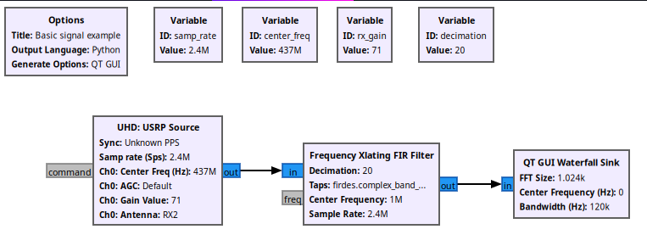
Filtering signals
Note that the sample rate is now 120k (divided by 20) after the filter
Centered at 1MHz on the right of the graph (348 MHz is now middle)

Slide 12
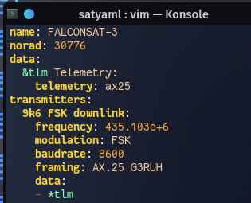
Getting data
Use the gr-satellite block to demodulate the signal into data
Gr-satellite takes parameters to determine what the job is
Here is an example:
* You can also apply on the GitHub to be integrated into the library!

Slide 13
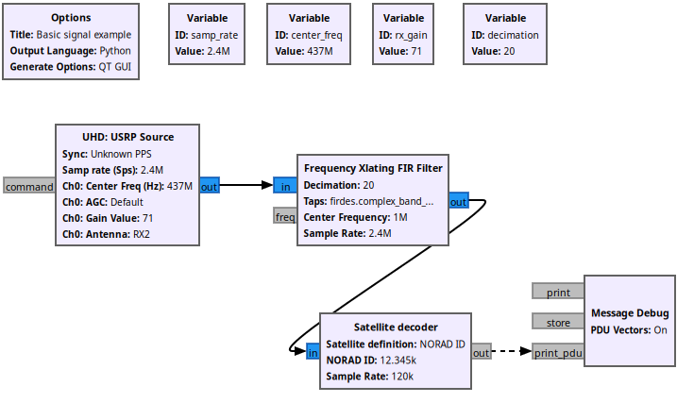
Getting data
Add the satellite decoder block with the .yaml file OR name OR norad

Slide 14
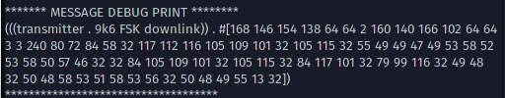
Getting data
Data will be printed out inside the gnuradio-companion console
WARNING: if you are reading via a .wav file instead of analogic sink, put a throttle (or else fire will occur)

Slide 15
Processing data
We need to find a way to handle each PDUs coming out of the satellite decoder block
Using ZMQ sockets we can send out the PDU to an external project
This external project can be written on any language that supports ZMQ
For this example, a small Python script will handle the data

Slide 16
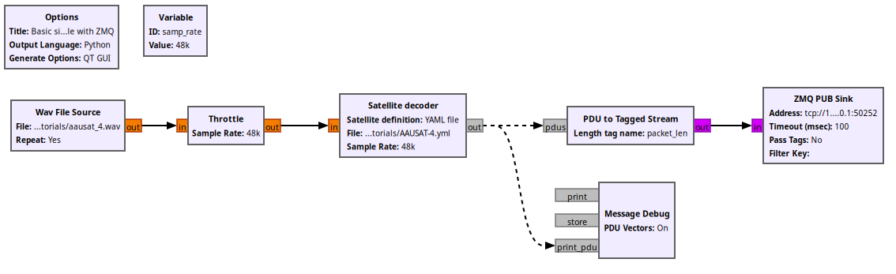
Processing data
Example with a .wav recording (to be able to test the flowgraph)

Slide 17
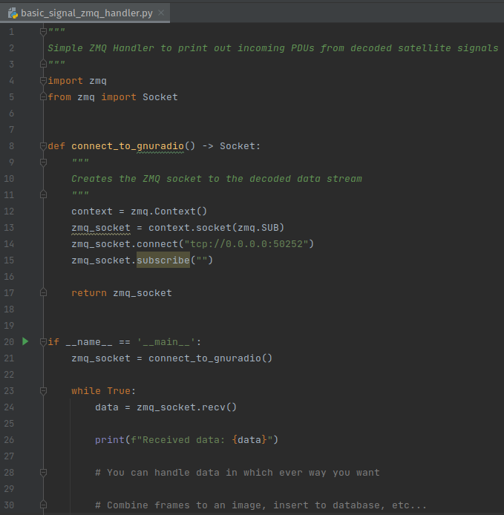
Processing data

Slide 18
Processing data
With a simple recording of a .wav, the whole ground station software can be developed
Independence of real-word test for a major part of development
Note: real-world signals on a 2.4MHz sample rate (complex) is about 5GB for 15 minutes

Slide 19
Doppler shift
Another major step to accomplish before decoding real-world signals correctly
Find a way to shift the signal each 100 milliseconds (at least) before demodulating
This component will use the strong advantage of coding everything in python
Passing data from an independent algorithm to the running flowgraph is possible

Slide 20
Doppler shift algorithm
Using TLE information we can calculate the shift needed
Using XMLRPC server, the new shift value is pushed on a running flowgraph via localhost
The doppler shift is controlled in a separate project by web requests

Slide 21
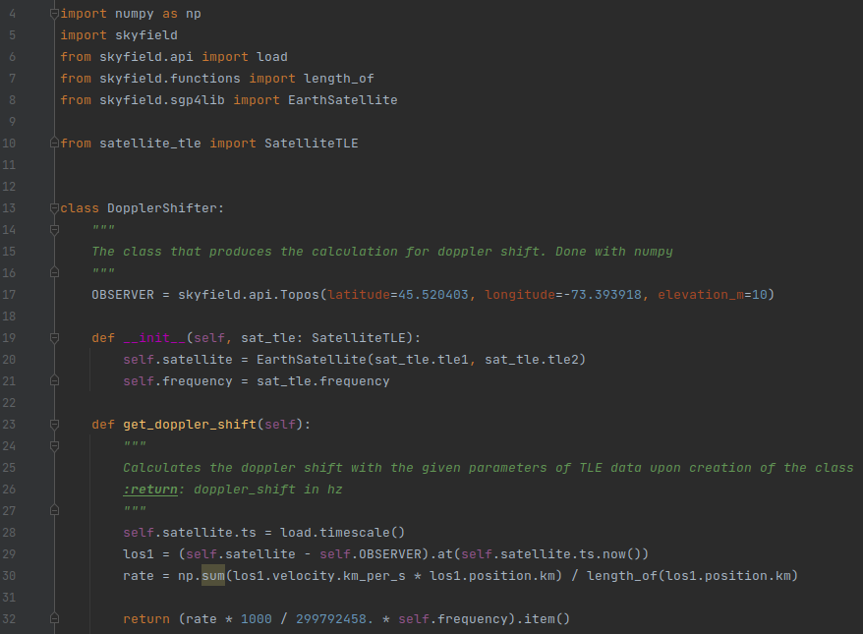
Doppler shift algorithm

Slide 22
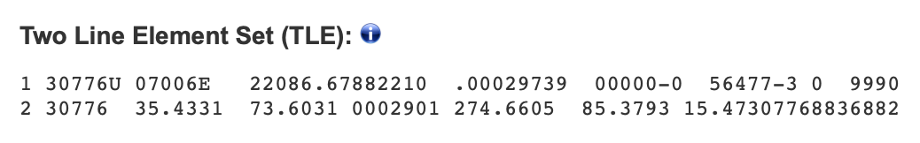
Doppler shift algorithm
TLE Information is fetched on the N2YO API
https://www.n2yo.com/api/#tle

Slide 23
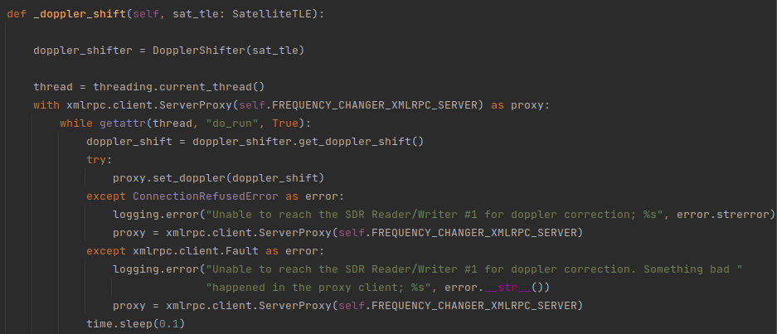
Doppler shift algorithm
Remember the xmlrpc.client.serverproxy !

Slide 24
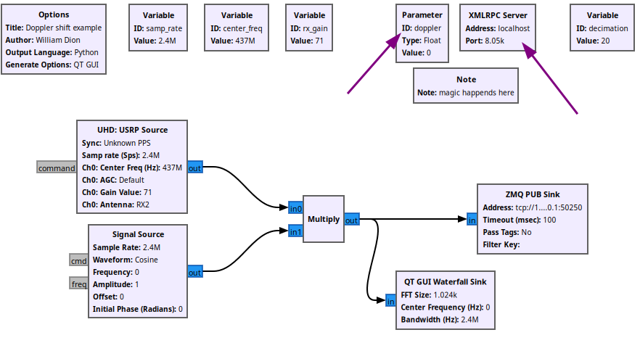
Doppler shift flowgraph

Slide 25
Doppler shift algorithm
The doppler shift project code is included in the files given at the end
Note that this service is started and stopped with a web request
You can re-use the code to make it work with a hardcoded TLE
This has been made generic to support any satellite with a changing TLE

Slide 26
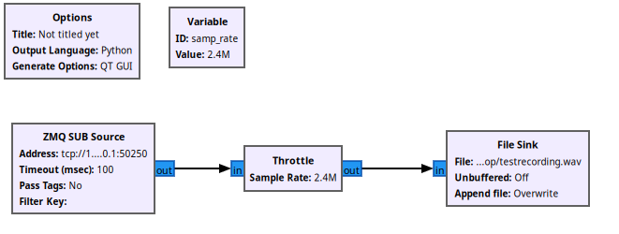
Record signal
Record a flyby to analyze with your pipeline later!

Slide 27
Uplink (BETA)
With an external Python app, we can send bytes to a flowgraph, that will convert it to a complex signal
The complex signal is fed to a USRP Sink
Note that this hasn’t been tested yet (waiting after license)

Slide 28
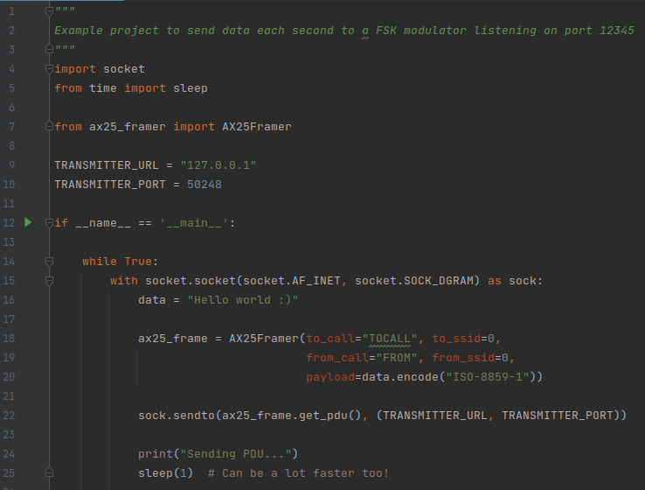
Uplink (BETA)
AX25 Frame is created with a framer
AX25 Frame is then sent to the local socket as a byte format

Slide 29
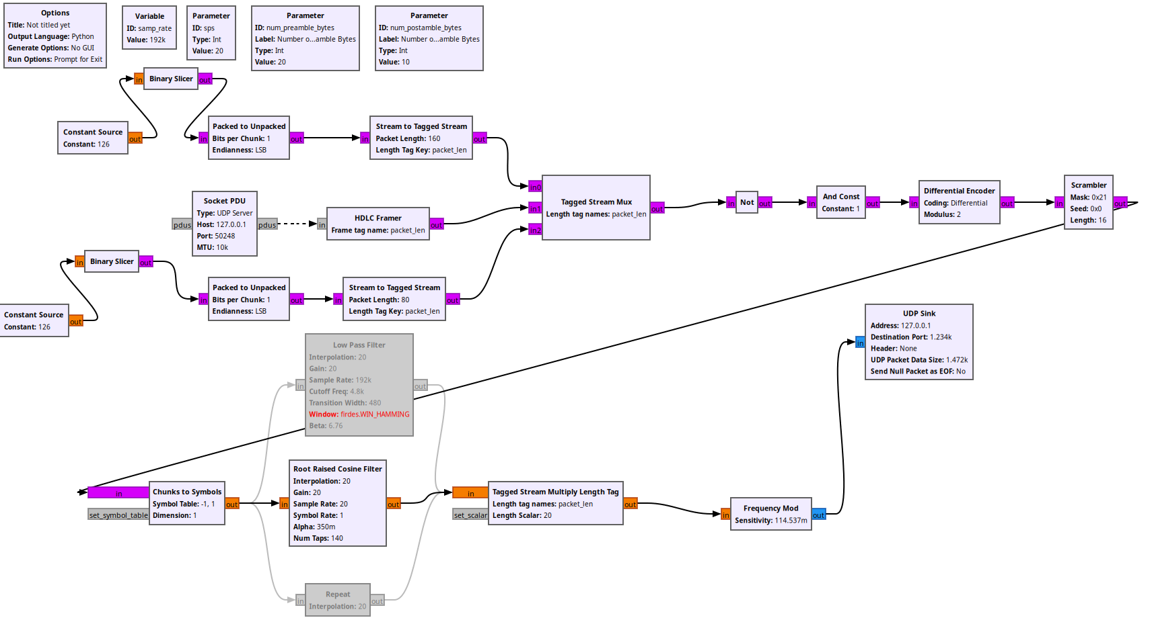
Uplink (BETA) – 9.6k Baud FSK
Credit: Peter Kazakoff

Slide 30
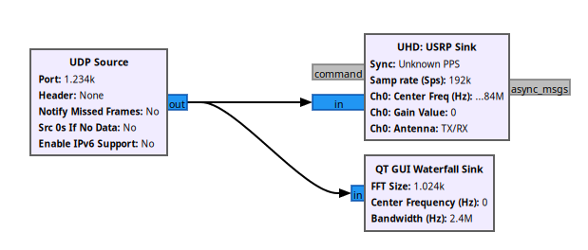
Uplink (BETA)
ZMQ Sink to USRP Sink

Slide 31
Orchestrate the ground station
We saw that the doppler shift is controlled with web requests on localhost
Complex signals can be passed on with local ZMQ Sockets
What if we made a central project that controls the whole flow of the ground station?
Downlink decoding
Uplink modulating

Slide 32
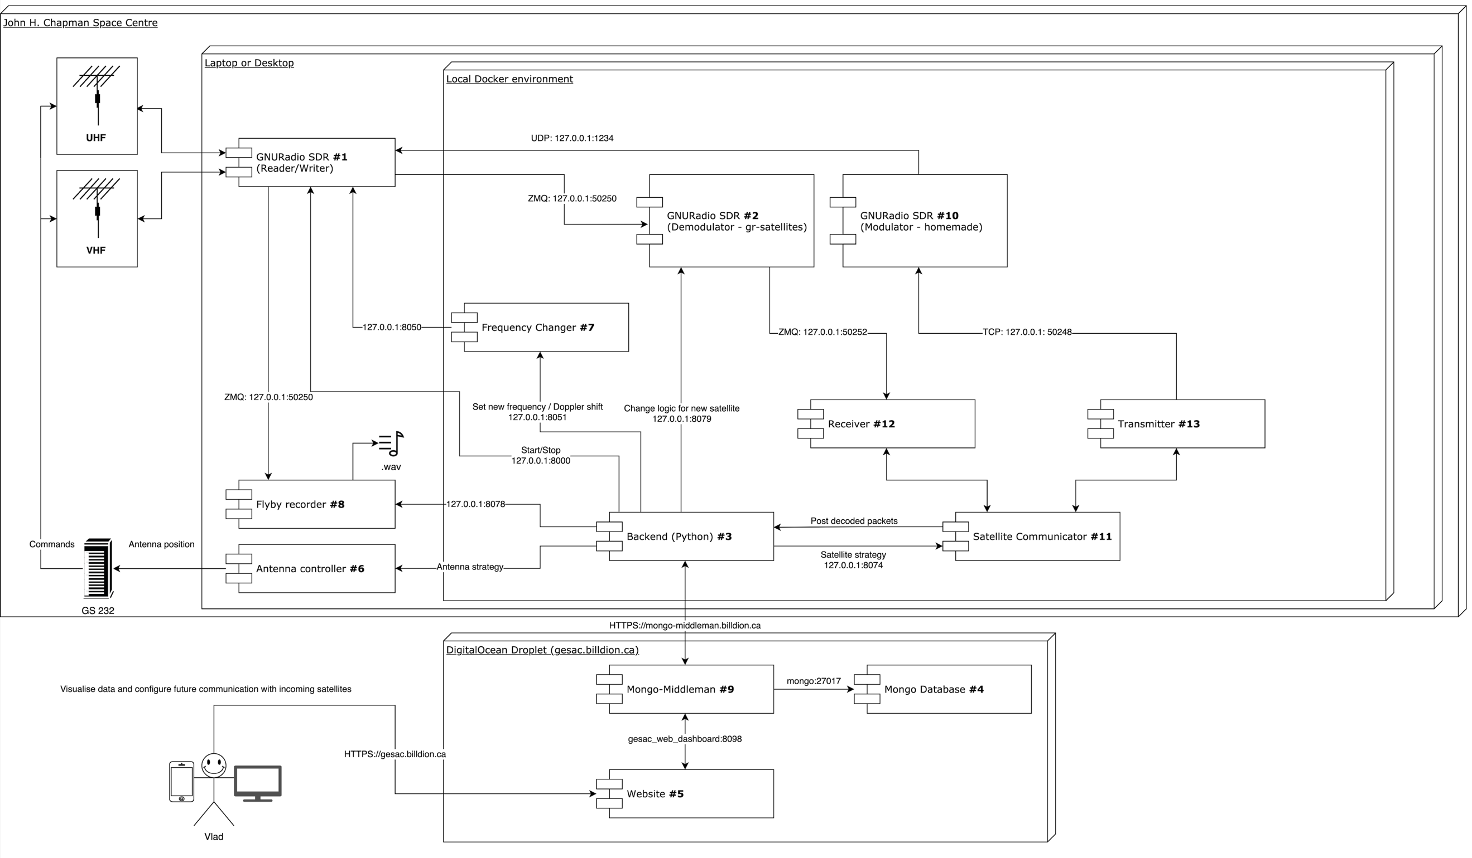
Central component: Backend (Python)

Slide 33
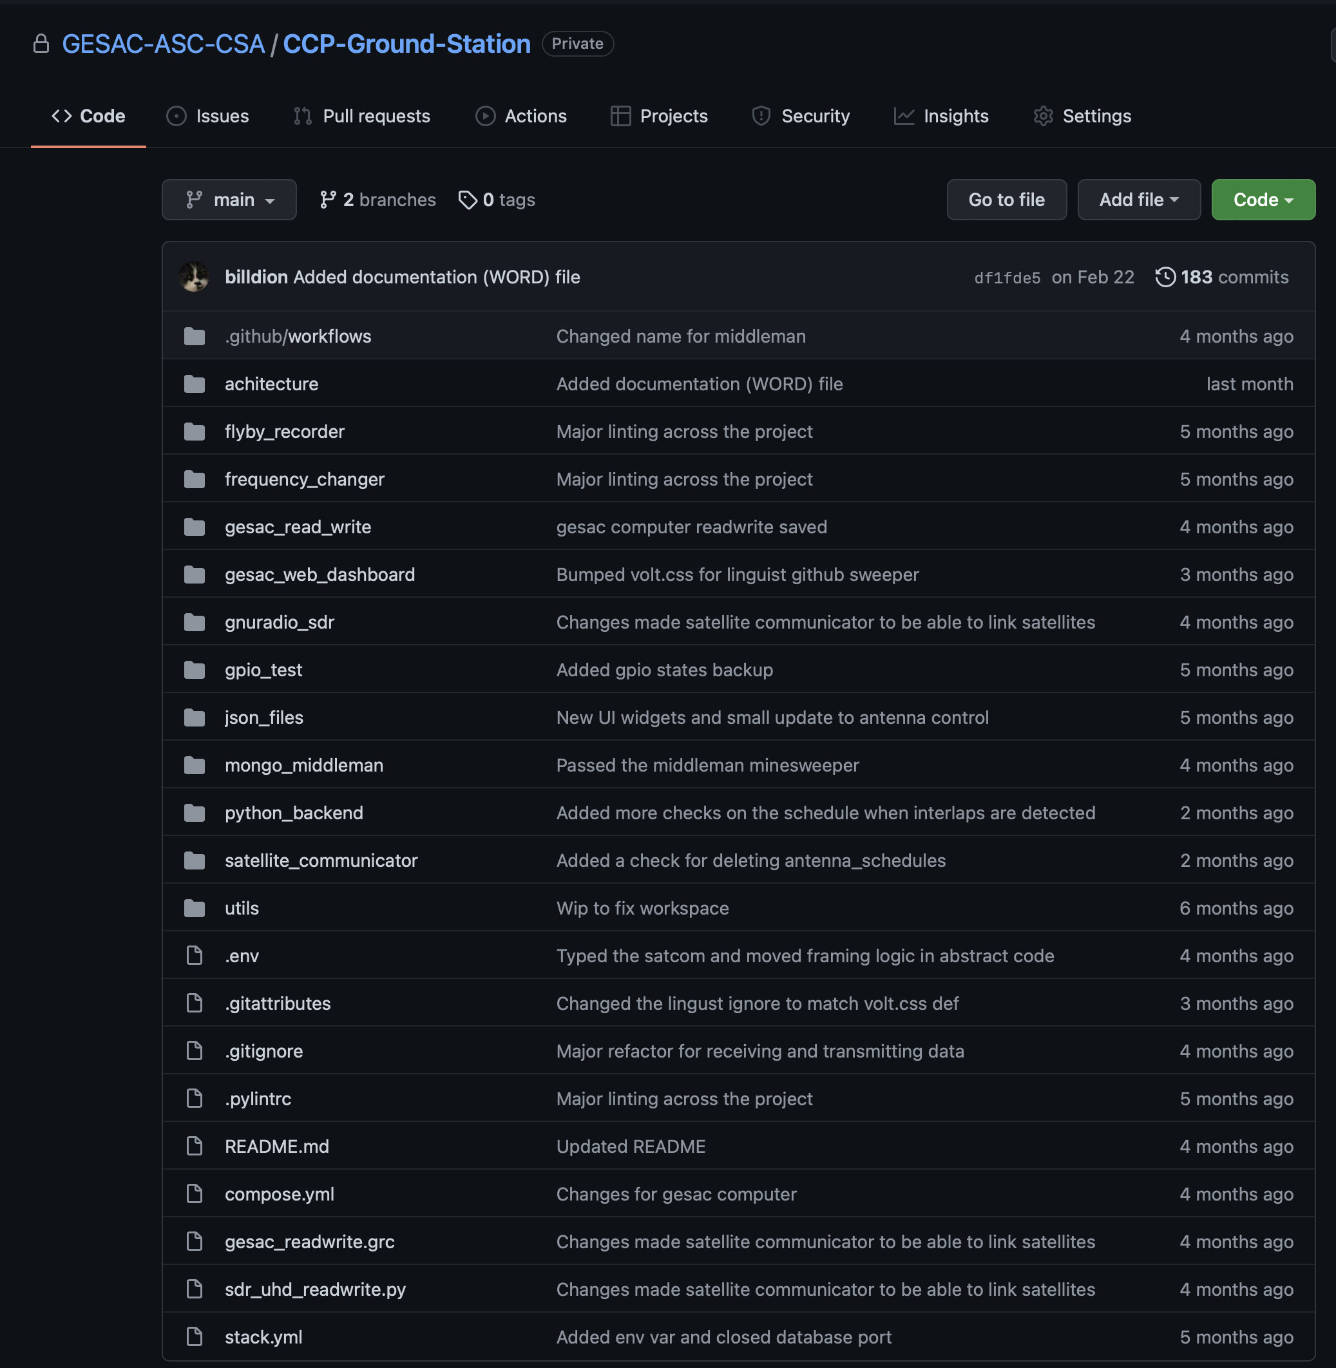
GitHub repo
Whole software architecture
Components are separated in containers (Docker)
Maybe talk about it next workshop?

Slide 34
Thanks! Questions?

Slide 35
Back-up Slides

Slide 36
Software Architecture

Slide 37
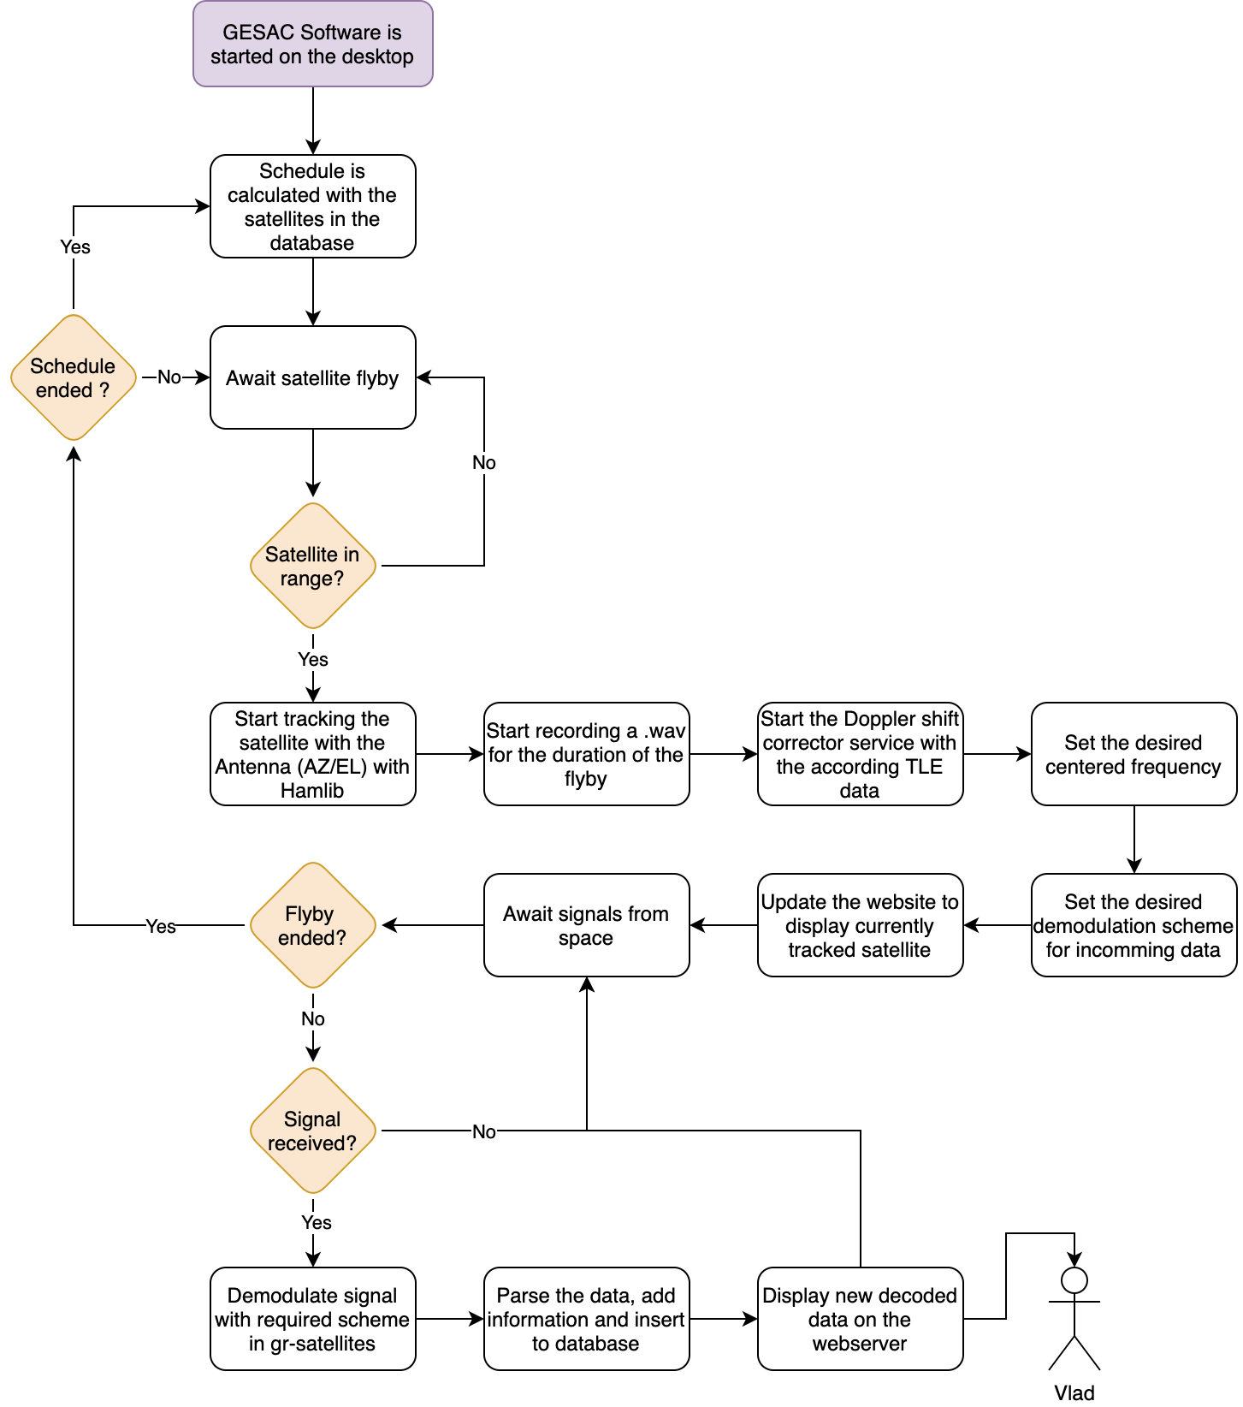
Receiver Work flow

